Slide 1
Point-Cloud Saliency Maps
Tianhang Zheng¹; Changyou Chen¹; Junsong Yuan¹; Bo Li²; Kui Ren²
¹University at Buffalo, the State University of New York
²Zhejiang University
Notes:
别用分号用逗号，buffalo标志放左上角

Slide 2
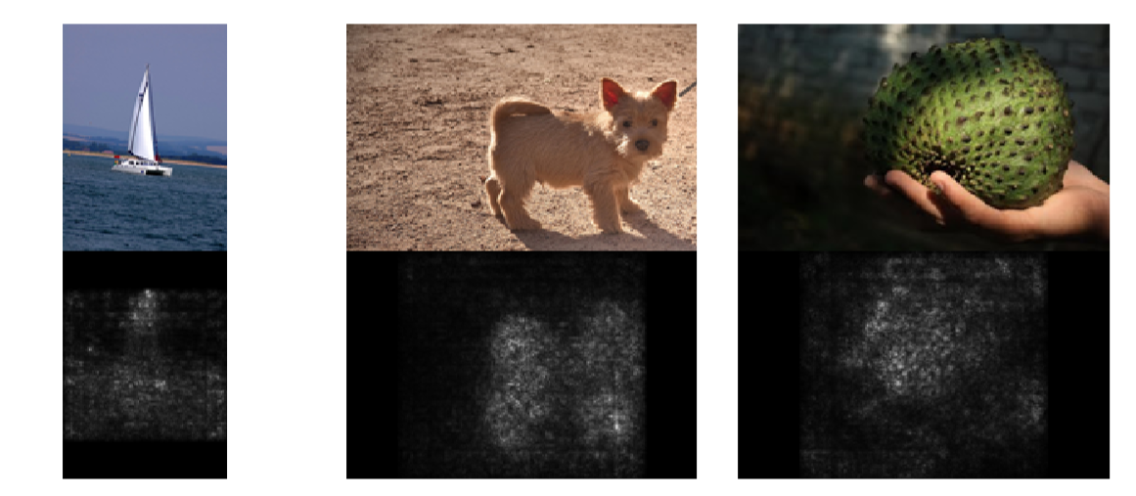
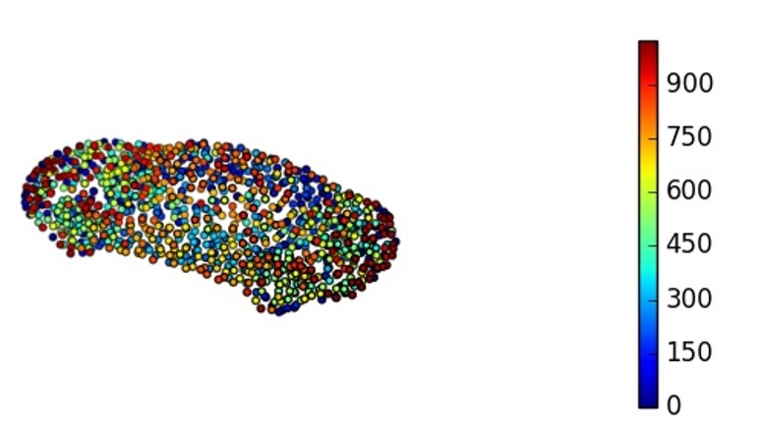
Saliency Maps
Given an image and the classification result.
How does each pixel gives contribution to the classification results?
Saliency Maps for Images
Saliency Map for Point Clouds
Notes:
美化一下

Slide 3
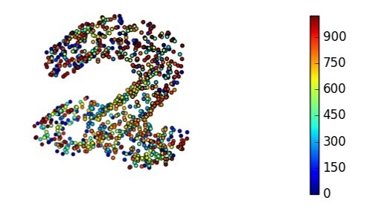
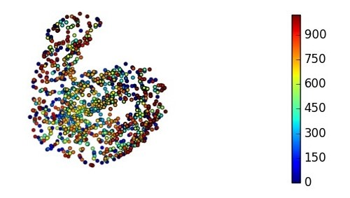
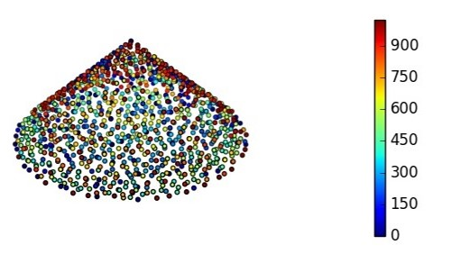
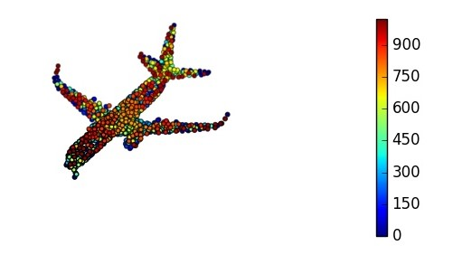
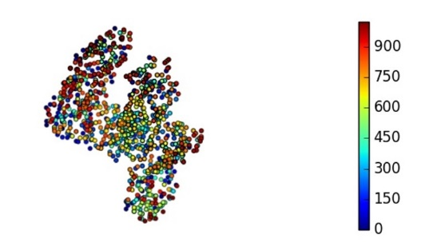
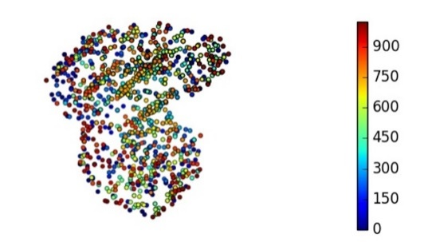
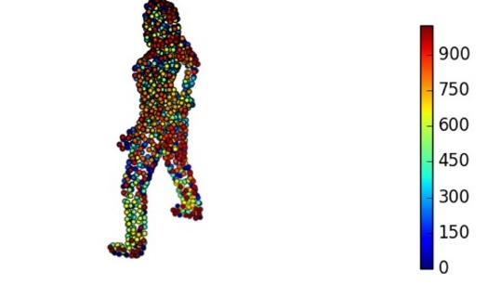

Point Cloud Saliency Maps
Saliency Score: Reflect the contribution of a point to the corresponding model-prediction loss
Calculate a saliency Score for each point

Slide 4
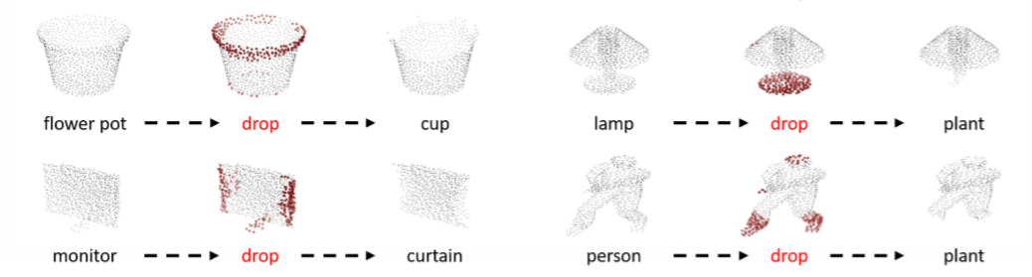

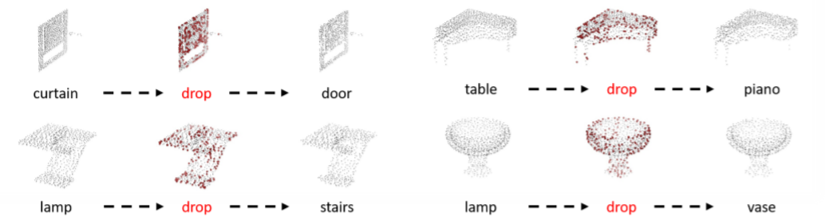
Point Cloud Saliency Maps
Point cloud saliency maps help us better understanding point-cloud data
High-drop: dropping points with the highest saliency scores
Launch Adversarial Attacks
Low-drop: dropping points with the lowest saliency scores
Model performance would not change a lot
Dropping points with negative scores even leads to better recognition performance

Slide 5


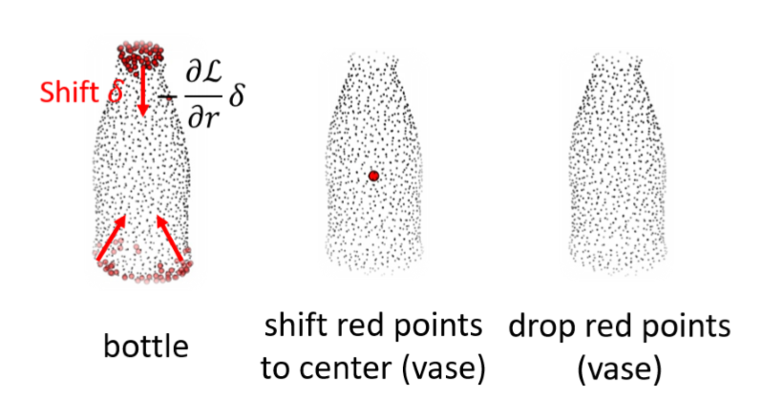
From Point Dropping to Point Shifting
Brute-force Method
Drop all possible combinations of points and compute the loss changes after dropping those combinations
Approximate point dropping with a continuous point-shifting procedure: moving points towards the point-cloud center
Our Method
Approximate point dropping with point shifting toward the point-cloud center
Notes:
Even only dropping each point (not combinations) and recalculating the losses are very time-consuming

Slide 6
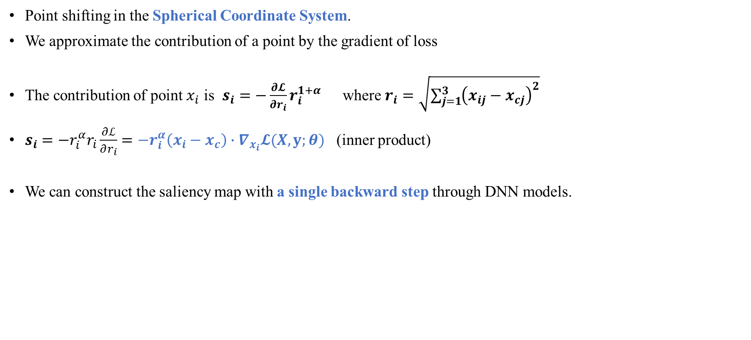
Gradient Based Saliency Map
Point shifting in the Spherical Coordinate System.
We approximate the contribution of a point by the gradient of loss
The contribution of point $x_{i}$ is $s_{i}=−\frac{∂𝓛}{∂r_{i}}r_{i}^{1+α}$ where $r_{i}=\sqrt{\sum_{j=1}^{3}{{\left(x_{ij}−x_{cj}\right)}^{2}}}$
$s_{i}=−r_{i}^{α}r_{i}\frac{∂ℒ}{∂r_{i}}=−r_{i}^{α}\left(x_{i}−x_{c}\right)∙∇_{x_{i}}𝓛(Χ,y;θ)$ (inner product)
We can construct the saliency map with a single backward step through DNN models.
Notes:
整理一下

Slide 7
Point Dropping Algorithms
Saliency-Map based Point Dropping
One Step Algorithm
Drop the points with n highest/lowest s_{i} from X
Iteratively Algorithm
for t = 0 to T do
Calculate each s_{i} for X^{t}
Drop the points with n/T highest/lowest s_{i} from X^{t}
Parameters
n: number of points to drop
T: number of iterations
s_{i}: saliency score for each point
X: point set
Suboptimal: Point dependencies have been ignored

Slide 8
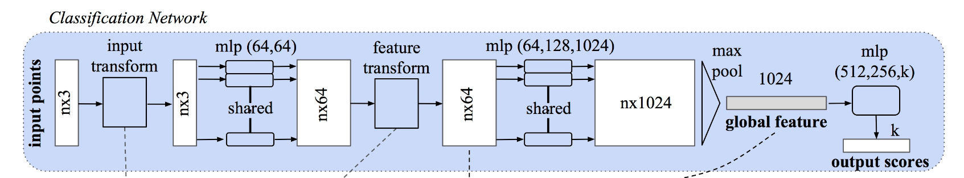
Point Dropping Algorithms
Critical-Subset based Point Dropping
Structure of PointNet
Critical-subset points give contribution to the global feature vector
Dropping the points with contribution to the most number of max-pooled features iteratively.

Slide 9
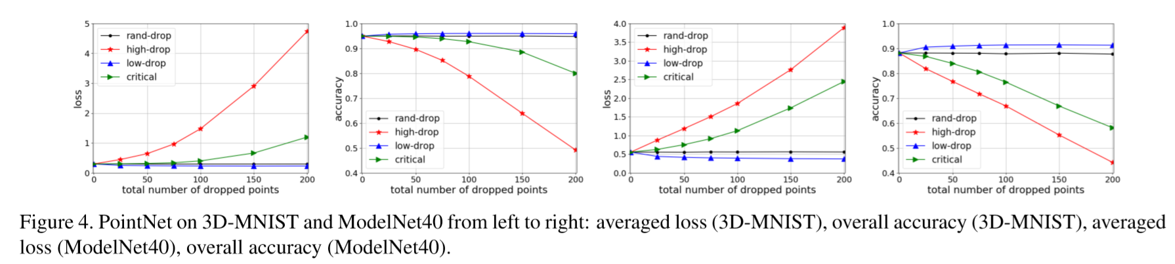
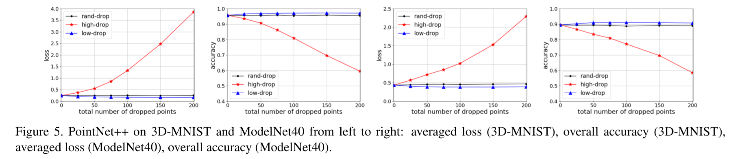
Result

Slide 10

Thank you!
GitHub: https://github.com/tianzheng4/PointCloud-Saliency-Maps
Email: tzheng4@buffalo.edu; boli@zju.edu.cn

